Slide 1
INSTA FOLLOWING ANALYSIS
2010030180- V. ABHIRAM
2010030168- TAHSEEN BEGUM
2010030394- A. RAGHAVENDRA GOUD
2010030142- R. VIVEK VARDHAN REDDY

Slide 2
TABLE OF CONTENTS
PROJECT AREA
LITERATURE SURVEY
PROBLEM STATEMENT
CONCLUSION

Slide 3
PROJECT AREA
DATA VISUALISATION

Slide 4
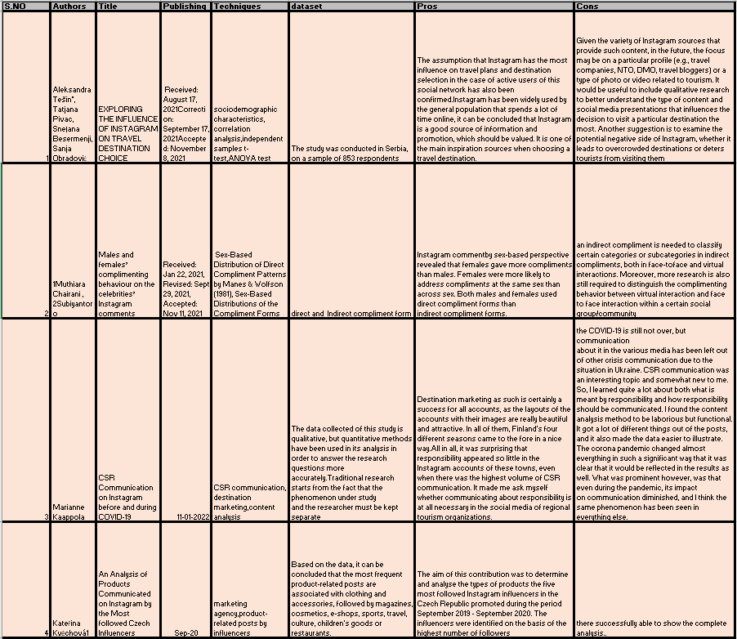
LITERATURE SURVEY

Slide 5
PROBLEM STATEMENT
our project is based on data visualization in which we have chosen to visualize the most followed celebrities on famous social media platform instagram using data visualisation techniques.

Slide 6
CONCLUSION
Summarising this presentation , we decided to analyze the data set of most following celebs in Instagram with data visualizing techniques.

